Slide 1
Programming Fundamental
Week 04
Sobia Iftikhar
Sobia.Iftikhar@nu.edu.pk

Slide 2
Class 10

Slide 3
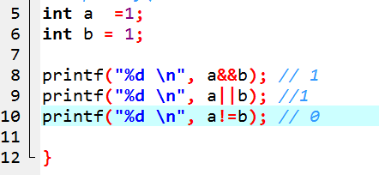
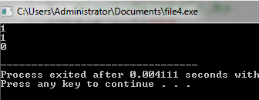
Example
How to perform logical operation on two different variables.

Slide 4
Conditional Operator
(condition)?
Printf():
Printf();

Slide 5
Example
Int feedbackRate
Int ExperienceRequried = 5;
(we>=ExperienceRequried && feedbackRate == feedbackRate )?
printf("Congratulation you get promotion"):
printf(“sorry not eligible "):

Slide 6
Example
Write a C program to print a grade sheet. For that program must take marks as input of six subjects from user at run time and find percentage and grade. Percentage must be shown with two value after point.

Slide 7
Solution
// int phy, chem, bio, math, comp;
// float per;
// printf("Enter phy subjects marks: ");
// scanf("%d", &phy);
// printf("Enter chem subjects marks: ");
// scanf("%d", &chem);
// printf("Enter bio subjects marks: ");
// scanf("%d", &bio);
// printf("Enter math subjects marks: ");
// scanf("%d", &math);
// printf("Enter comp subjects marks: ");
// scanf("%d", &comp);
// per = (phy + chem + bio + math + comp) / 5.0;
// printf("Percentage of marks = %.2f\n", per);
// (per >= 90)?
// printf("//////////// Grade A ////////////\n"):
// (per >= 80)?
// printf("//////////// Grade B ////////////\n"):
// (per >= 70)?
// printf("//////////// Grade C ////////////\n"):
// (per >= 60)?
// printf("//////////// Grade D //////////// \n"):
// (per >= 40)?
// printf("//////////// Grade E //////////// \n"):
// printf("//////////// Grade F //////////// \n");

Slide 8
Prefix and Postfix Increment
Prefix increment
c = 5;
x = ++c; /* value of c is 6 and x
is 6 */
Postfix increment
c = 5;
x = c++;
/* value of c is 6 but x is 5 */

Slide 9
Example
x = 4 y = ++x PRINT x PRINT y | X = ? and y =? Reason
x = 3 y = x++ PRINT x PRINT y | X = ? and y =? Reason
x = 3 y = --x PRINT x PRINT y | X = ? and y =? Reason
x = 3 y = x-- PRINT x PRINT y | X = ? and y =? Reason

Slide 10
Bitwise operators
Operators | Meaning of operators
& | Bitwise AND
| | Bitwise OR
^ | Bitwise XOR
~ | Bitwise complement
<< | Shift left
>> | Shift right

Slide 11
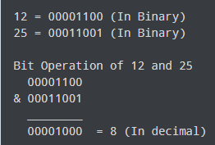
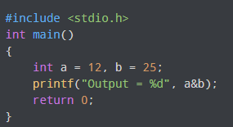
& -AND Operator
a | b | a&b | a|b | ~b | a^b
0 | 0 | 0 | 0 | 1 | 0
0 | 1 | 0 | 1 | 0 | 1
1 | 0 | 0 | 1 | 1 | 1
1 | 1 | 1 | 1 | 0 | 0

Slide 12
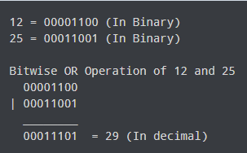
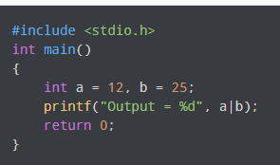
& -AND Operator
a | b | a&b | a|b | ~b | a^b
0 | 0 | 0 | 0 | 1 | 0
0 | 1 | 0 | 1 | 0 | 1
1 | 0 | 0 | 1 | 1 | 1
1 | 1 | 1 | 1 | 0 | 0

Slide 13
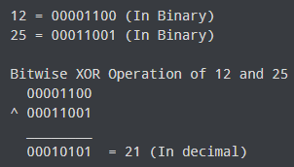
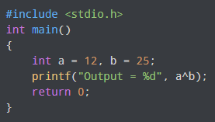
& -AND Operator
a | b | a&b | a|b | ~b | a^b
0 | 0 | 0 | 0 | 1 | 0
0 | 1 | 0 | 1 | 0 | 1
1 | 0 | 0 | 1 | 1 | 1
1 | 1 | 1 | 1 | 0 | 0

Slide 14
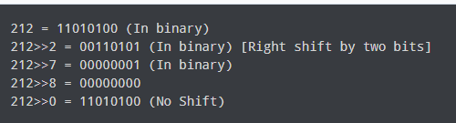
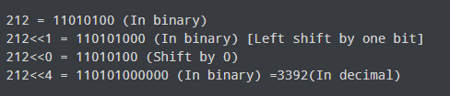
Shift Operator- left and Right
:
Right shift operator
Left shift operator.
There are two shift operators in C programming

Slide 15
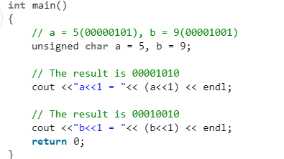
Example
Two inputs from user a character data type and perform shift left and right operator.

Slide 16
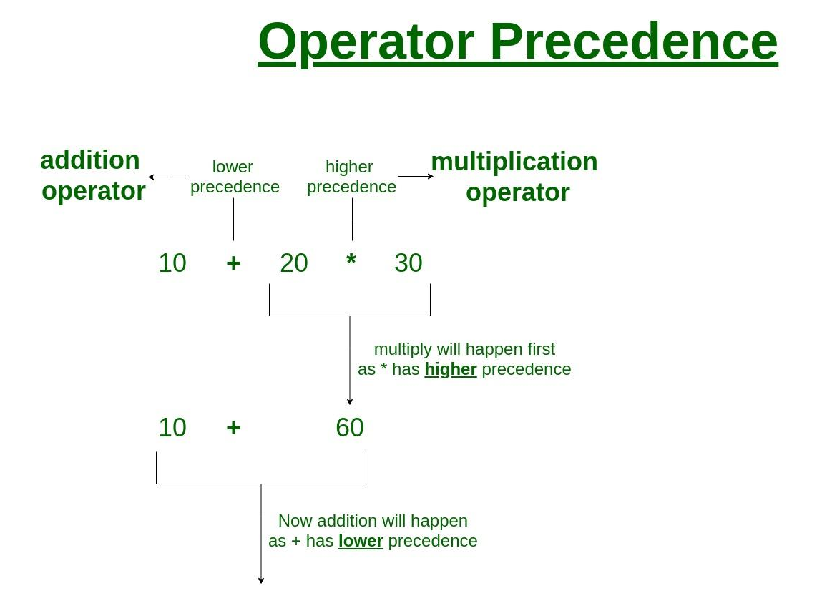
Operators Precedence in C

Slide 17
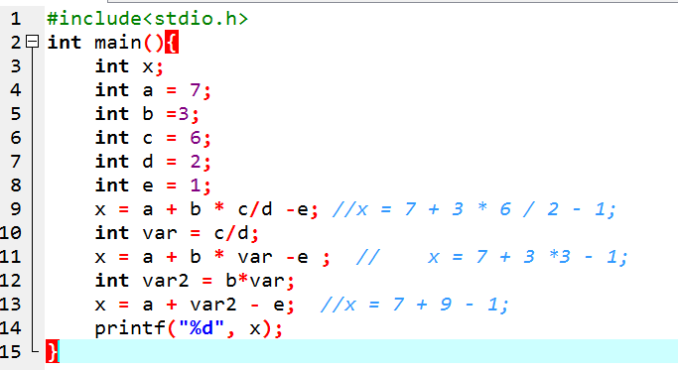
Example

Slide 18
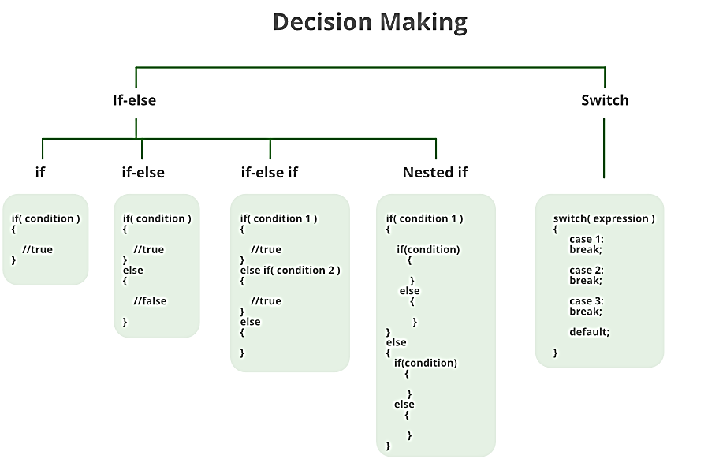
Decision Concept
Introduction to conditional statements
If structure
If –else structure
If-else-if structure
Switch statements

Slide 19
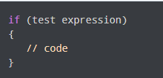
If statement
The syntax of the if statement in C programming is:
The if statement evaluates the test expression inside the parenthesis ().
If the test expression is evaluated to true, statements inside the body of if are executed.
If the test expression is evaluated to false, statements inside the body of if are not executed.

Slide 20
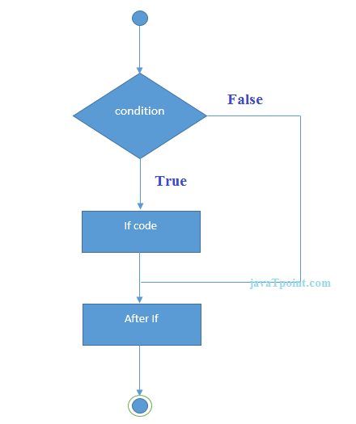
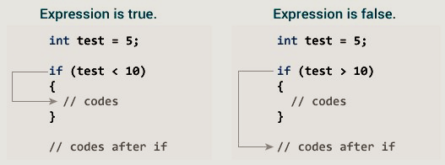
Example

Slide 21
Example 1: if statement
#include <stdio.h>
int main() {
int number;
printf("Enter an integer: ");
scanf("%d", &number);
// true if number is less than 0
if (number < 0) {
printf("You entered %d.\n", number);
}
printf("The if statement is easy.");
return 0;
}
Enter an integer: -2
You entered -2.
The if statement is easy.
Enter an integer: 5
The if statement is easy.

Slide 22
Example
Program to find the largest number of the three.
int main()
{
int a, b, c;
printf("Enter three numbers?");
scanf("%d %d %d",&a,&b,&c);
if(a>b && a>c)
{
printf("%d is largest",a);
}
if(b>a && b > c)
{
printf("%d is largest",b);
}
if(c>a && c>b)
{
printf("%d is largest",c);
}
if(a == b && a == c)
{
printf("All are equal");
}
}

Slide 23
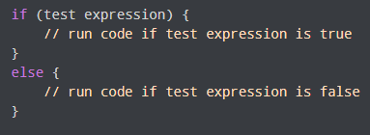
C if...else Statement
How if...else statement works?
If the test expression is evaluated to true,
statements inside the body of if are executed.
statements inside the body of else are skipped from execution.
If the test expression is evaluated to false,

Slide 24
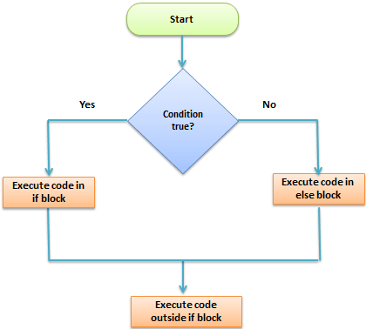
Work flow

Slide 25
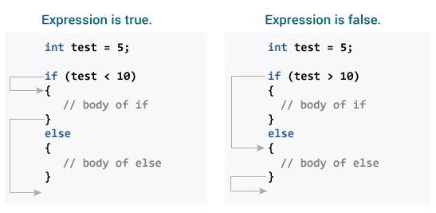
Example

Slide 26
Example 2: if...else statement
#include <stdio.h>
int main() {
int number;
printf("Enter an integer: ");
scanf("%d", &number);
// True if the remainder is 0
if (number%2 == 0) {
printf("%d is an even integer.",number);
}
else {
printf("%d is an odd integer.",number);
}
return 0;
}
Enter an integer: 7
7 is an odd integer.

Slide 27
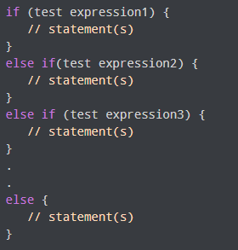
If else-if
The if...else statement executes two different codes depending upon whether the test expression is true or false. Sometimes, a choice has to be made from more than 2 possibilities.
The if...else ladder allows you to check between multiple test expressions and execute different statements.

Slide 28
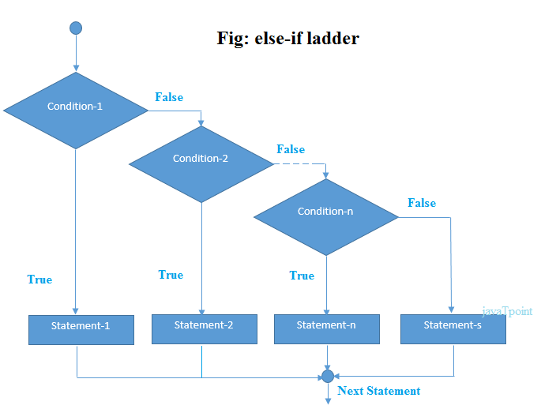
Flowchart

Slide 29
Example
#include <stdio.h>
int main() {
int number1, number2;
printf("Enter two integers: ");
scanf("%d %d", &number1, &number2);
//checks if the two integers are equal.
if(number1 == number2) {
printf("Result: %d = %d",number1,number2);
}
//checks if number1 is greater than number2.
else if (number1 > number2) {
printf("Result: %d > %d", number1, number2);
}
//checks if both test expressions are false
else {
printf("Result: %d < %d",number1, number2);
}
return 0;
}
Enter two integers: 12 23
Result: 12 < 23

Slide 30
Example
#include <stdio.h>
int main () {
int a = 100;
if( a == 10 ) {
printf("Value of a is 10\n" );
} else if( a == 20 ) {
printf("Value of a is 20\n" );
} else if( a == 30 ) {
printf("Value of a is 30\n" );
} else {
printf("None of the values is matching\n" );
}
printf("Exact value of a is: %d\n", a );
return 0;
}

Slide 31
Difference between (if vs else if)
Int num = 40;
//this first condition is checked, evaluates to `false`, the next condition will be checked
if(num < 40){
//do something
}
//the previous condition was evaluated to `false` so the following condition will be checked, and it evaluates to `true` so code inside this `else if` block will execute
else if(num >= 10 && num <= 50) {
//do something else
}
//the following condition will not be checked as the previous condition evaluated to `true`
else if(num > 50) {
//do a thing
}

Slide 32
Difference between (if vs else if)
let num = 40;
//the following condition evaluates to `false`, the next condition will be checked
if(num < 10){
//do something
}
//the following condition is the only on that evaluates to `true`, code inside this `if` block will execute
if(num >= 10 && num <= 50) {
printf('test');
}
//this condition will still be checked even though the previous condition was evaluated to `true`
if(num > 50) {
//do a thing
}

Slide 33
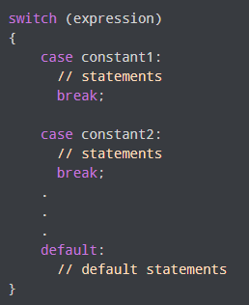
Switch statement
The expression is evaluated once and compared with the values of each case label.
If there is a match, the corresponding statements after the matching label are executed. For example, if the value of the expression is equal to constant2, statements after case constant2: are executed until break is encountered.
If there is no match, the default statements are executed.

Slide 34
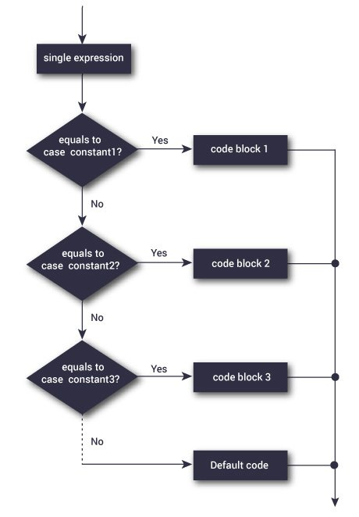
Flowchart

Slide 35
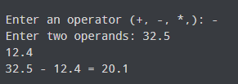
Example: Simple Calculator
switch(operator)
{
case '+':
printf("%.1lf + %.1lf = %.1lf",n1, n2, n1+n2);
break;
case '-':
printf("%.1lf - %.1lf = %.1lf",n1, n2, n1-n2);
break;
case '*':
printf("%.1lf * %.1lf = %.1lf",n1, n2, n1*n2);
break;
case '/':
printf("%.1lf / %.1lf = %.1lf",n1, n2, n1/n2);
break;
// operator doesn't match any case constant +, -, *, /
default:
printf("Error! operator is not correct");
}
return 0;
}
#include <stdio.h>
int main() {
char operator;
double n1, n2;
printf("Enter an operator (+, -, *, /): ");
scanf("%c", &operator);
printf("Enter two operands: ");
scanf("%lf %lf",&n1, &n2);

Slide 36
Example
#include <stdio.h>
int main() {
int language = 10;
switch (language) {
case 1:
printf("C#\n");
break;
case 2:
printf("C\n");
break;
case 3:
printf("C++\n");
break;
default:
printf("Other programming language\n");}}
Other programming language

Slide 37
Example
#include <stdio.h>
int main() {
int number=5;
switch (number) {
case 1:
case 2:
case 3:
printf("One, Two, or Three.\n");
break;
case 4:
case 5:
case 6:
printf("Four, Five, or Six.\n");
break;
default:
printf("Greater than Six.\n");}}
When working with switch case in C, you group multiple cases with unique labels. You need to introduce a break statement in each case to branch at the end of a switch statement.

Slide 38


Example
#include <stdio.h>
int main()
{
int a = 10;
int b = 20;
switch (a == 10 && b > 30)
{
case 1:
printf("CaseD ");
break;
case 0:
printf("CaseB");
break;
default:
printf("Default ");
} return 0;}
#include <stdio.h>
int main()
{
int a = 10;
switch (a == 10)
{
case 1:
printf("CaseD ");
break;
case 0:
printf("CaseB");
break;
default:
printf("Default ");
} return 0;}

Slide 39
Important
1) Case doesn’t always need to have order 1, 2, 3 and so on. They can have any integer value after case keyword. Also, case doesn’t need to be in an ascending order always, you can specify them in any order as per the need of the program.
2) You can also use characters in switch case

Slide 40
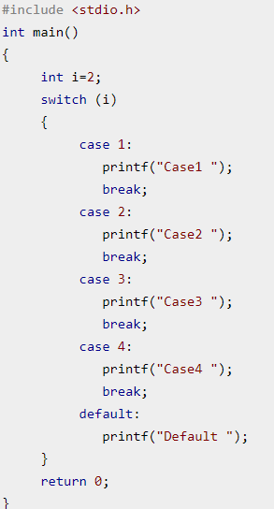
Why break;
Case 2
Break statements are useful when you want your program-flow to come out of the switch body. Whenever a break statement is encountered in the switch body, the control comes out of the switch case statement.
What if ? We forget to write “break” keyword?

Slide 41
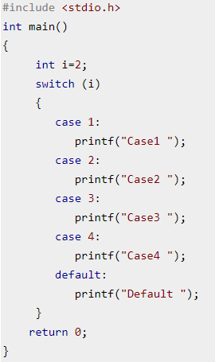
Why break;
Break statements are useful when you want your program-flow to come out of the switch body. Whenever a break statement is encountered in the switch body, the control comes out of the switch case statement.
What if ? We forget to write “break” keyword?
Case2 Case3 Case4 Default

Slide 42
switch Versus if-else Ladder
There are some things that you simply cannot do with a switch.
A float expression cannot be tested using a switch
The case keyword is followed by an integer or a character constant.
Cases can never have variable expressions
(for example it is wrong to say case a +3 : )

Slide 43
The goto Keyword
int goals ;
printf ( "Enter the number of goals scored against India" ) ;
scanf ( "%d", &goals ) ;
if ( goals <= 5 )
goto sos ;
else
{
printf ( "About time soccer players learnt C\n" ) ;
printf ( "and said goodbye! adieu! to soccer" ) ;
exit( ) ; /* terminates program execution */
}
sos :
printf ( "To err is human!" ) ;

Slide 44
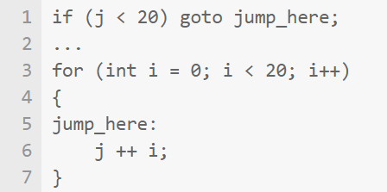
Drawback
What is the value of ‘i’ in this case? What’s getting added to j? Who knows?

Slide 45
Task
There is IT company who started their startup few months ago, currently this organization consist on two departments, 1) Software Department and 2) Development Department. Initially this organization hired 6 six employs each employee has unique ID (ex: 11)
Three employees assign to each department on the basis of their skills.
Write a c program that will take input from a user as ID. And display the assigned department. Using switch statement

Slide 46
Example
Example 2.1: While purchasing certain items, a discount of 10% is offered if the quantity purchased is more than 1000. If quantity and price per item are input through the keyboard, write a program to calculate the total expenses.

Slide 47
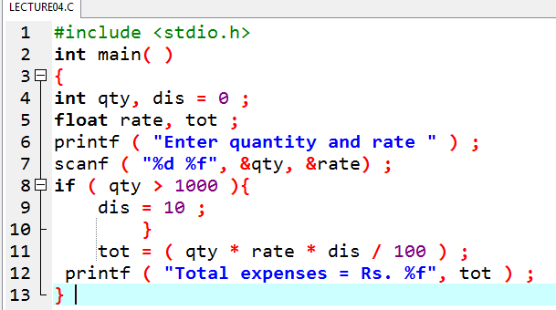
Solution

Slide 48
Example
Example 2.2: The current year and the year in which the employee joined the organization are entered through the keyboard. If the number of years for which the employee has served the organization is greater than 3 then a bonus of Rs. 2500/- is given to the employee. If the years of service are not greater than 3, then the program should do nothing

Slide 49
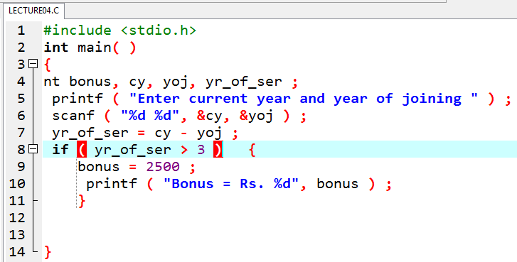
Solution

Slide 50
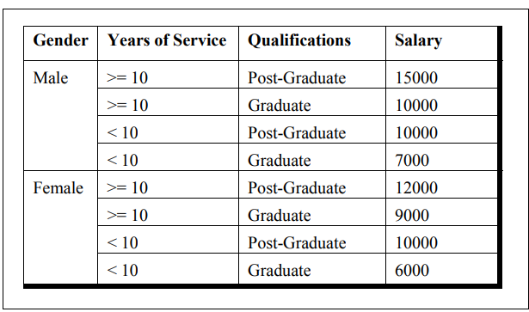
Write a program to calculate the salary as per the following table:

Slide 51
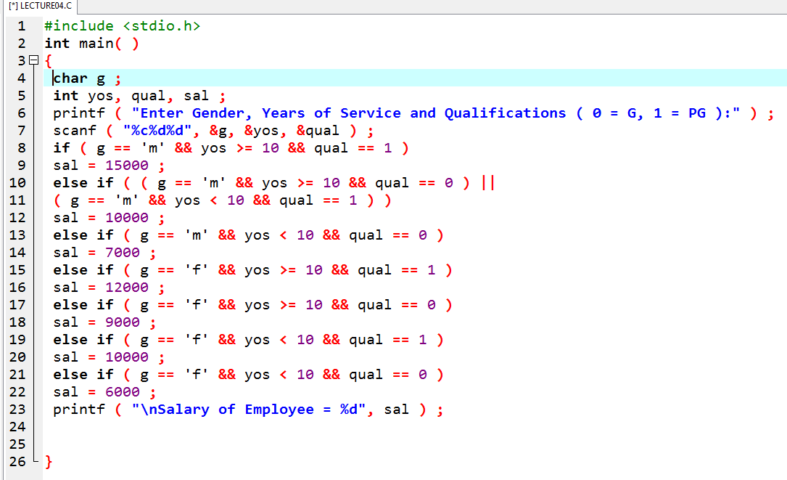

Slide 52
Thankyou

